Slide 1
Evaluation and Improvement of Fast Algorithms for Exact Matching on Genome Sequences
Author: Simone Faro
Conference on Algorithms for Computational Biology, 2016
Presented By: Kaitav Mehta
Student ID: 104911444

Slide 2
Content
Why we compare Genome Sequence?
Problem Definition
Previous Algorithms
BNDM Algorithm Explained with Example
Two-way Shift-Or algorithm Explained with Example
Two Improved Versions of BNDM algorithm explained
Conclusion and Future work

Slide 3
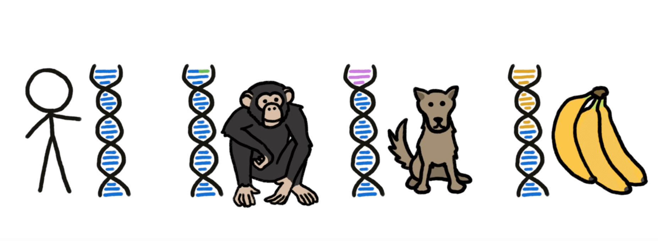
Are we really 99% ape?
It’s often said that we share 50% of our DNA with banana
80% with dogs and 99% with chimps
So the question is are we really 99% apes? How do we figure that out?

Slide 4
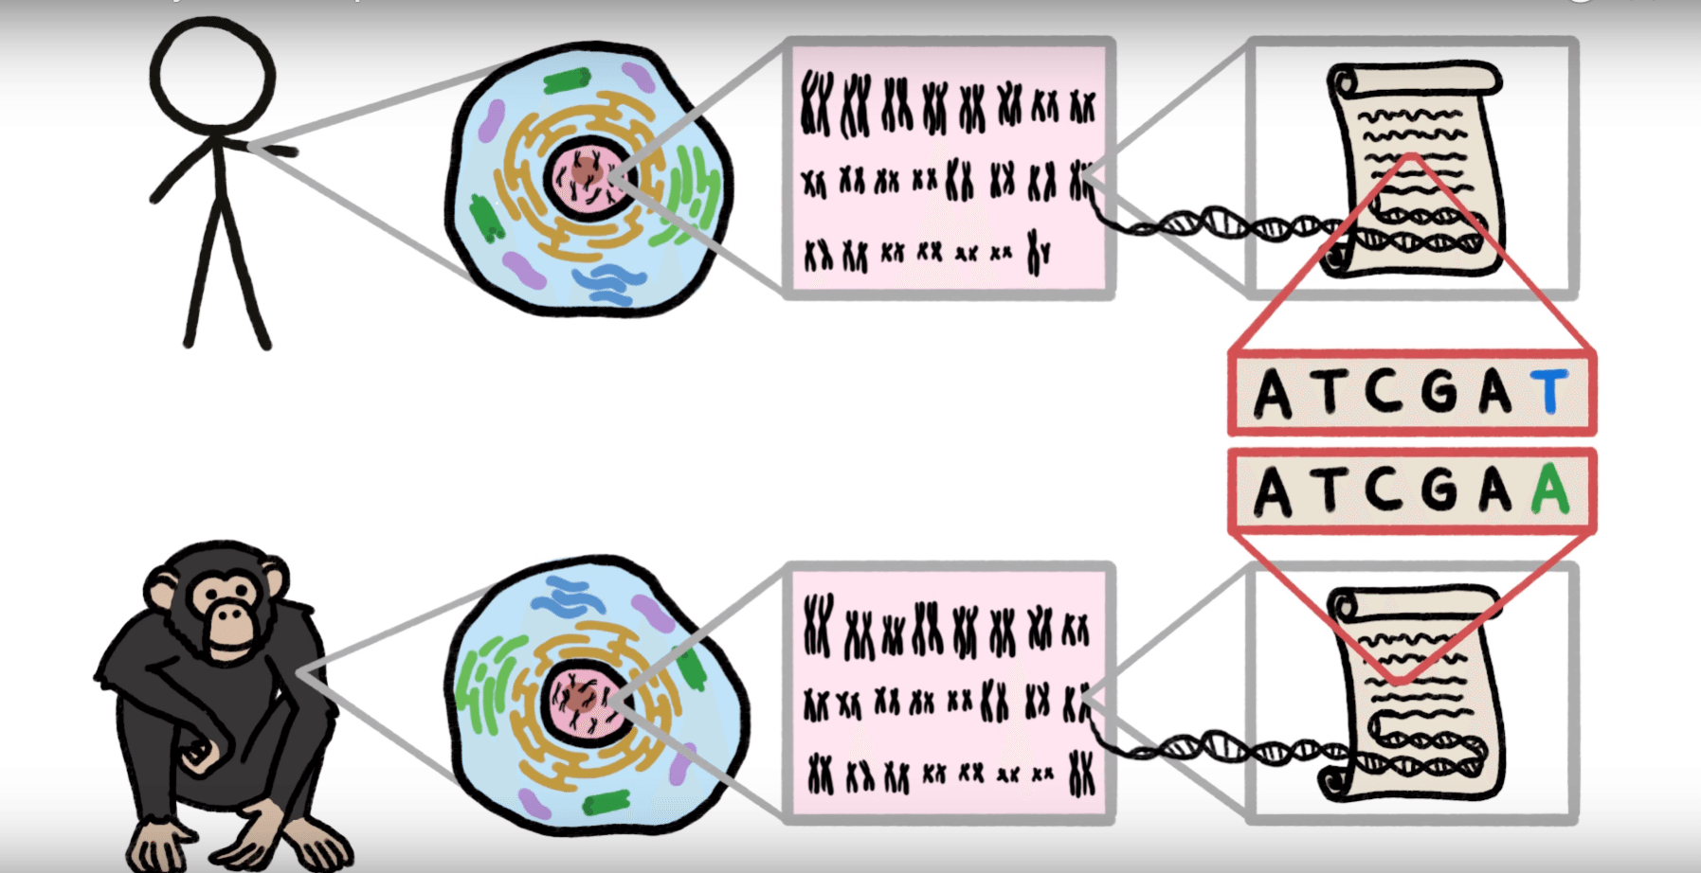
So can we pull out chromosome from human and ape, separate it in chromosomes, convert it to genomes and read out them literally?

Slide 5
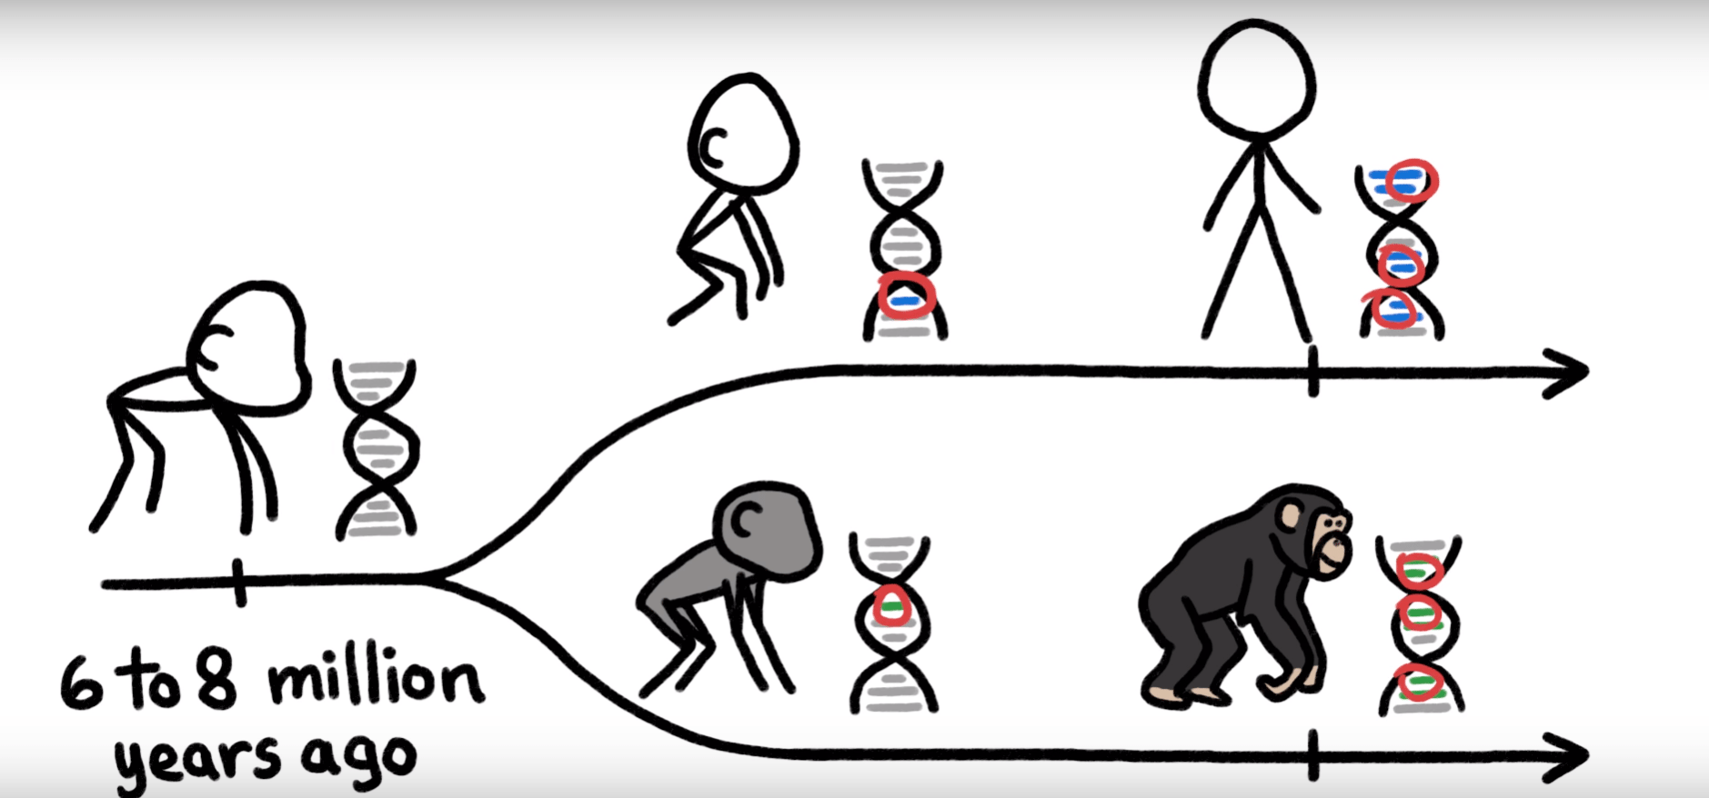
Since we split from our last common ancestors,chance mutations and natural selections have changed our genome in radical and unique way.

Slide 6
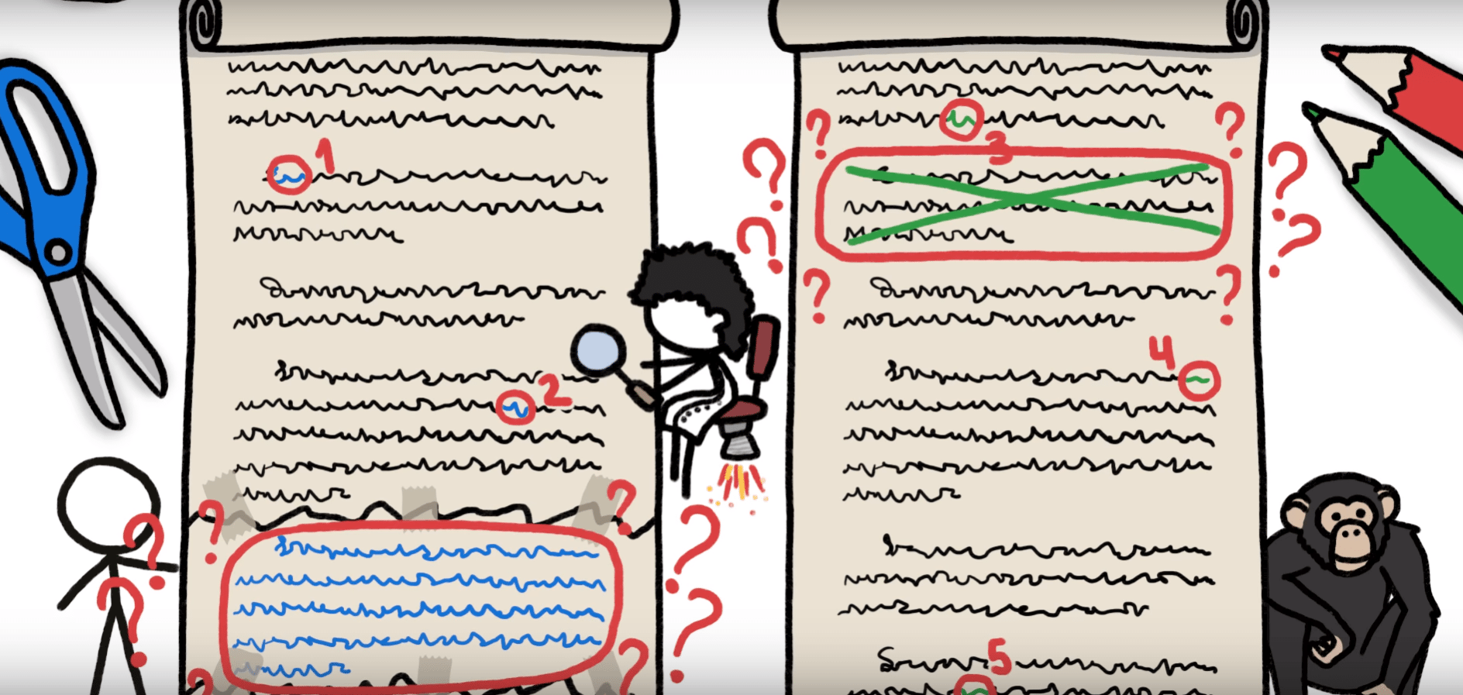
When researchers sat down to compare chimps and human genomes
The single letters difference were easy to tally but the big mismatch sections weren’t.

Slide 7
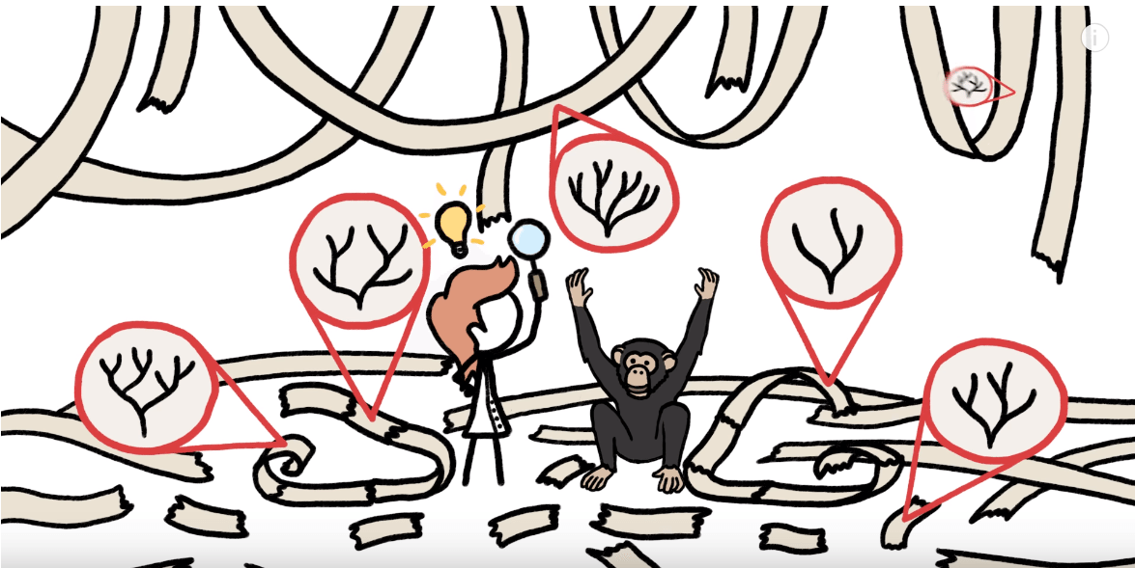
DNA contains the record of the evolutionary relationships between all organism.
It's a garbled record but by reading closely we have been able to glean enough information to refine our drawing evolutionary tree which we have been building long before the genome sequencing.

Slide 8

We may not be 99% of actually chimp but we are 100% great ape and at least a little banana

Slide 9
Problem Definition:
Input : A text T and a pattern P.
Output : All the locations where P matches T.

Slide 10
Previous algorithms: BNDM and its variants
BNDM(Backward Nondeterministic DAWG Matching) is the bit-parallel simulation of an earlier algorithm called BDM (Backward DAWG Matching).
BDM scans the alignment window from right to left and skips characters using a suffix automaton.

Slide 11
Previous algorithms: Shift-Or and its variants
The Shift-Or algorithm was the first string matching algorithm applying bit- parallelism.
Operands in the algorithm are bit-vectors and the essential bit-vector containing the state of the automaton is called the state vector.
The state vector is updated with the bit-shift and OR operations.

Slide 12
Previous algorithms: For the k-mismatches problem
Shift-Add is a bit-parallel algorithm for the k-mismatches problem.
A state vector D of m states is used to represent the state of the search.

Slide 13
The Backward Nondeterministic DAWG Matching Algorithm

Slide 14

This algorithm uses rule: Suffix to Prefix Rule:
For a window to have any chance to match a pattern, in some way, there must be a suffix of the window which is equal to a prefix of the pattern.
T
P

Slide 15

Find the longest suffix U of the window which is equal to some prefix of P. Skip the pattern as follows:
U

Slide 16
Example
T = GCA TCGACAGAC TATACAGTACG
P = GACGGATCA
∵The longest suffix of the window which is equal to a prefix of P is “GAC”, slide the window by 6.
T = GCATCGACAGACTATACAGTACG
P = GACGGATCA

Slide 17
We give an example to introduce how this algorithm find the longest
suffix of the window which is equal to a prefix of P.

Slide 18
Example :
Text : ABDDCCDBADEGGGGJJ
Pattern : BADADCEAD
We want to find the longest suffix of “BDDCCDBAD” which is also
a prefix of the pattern.

Slide 19
Example:
Text : ABDDCCDBADEGGGGJJ
Pattern : BADADCEAD
First, we read “D”.

Slide 20
Example:
Text : ABDDCCDBADEGGGGJJ
Pattern : BADADCEAD
We find all the substrings ”D” in the pattern.

Slide 21
Example:
Text : ABDDCCDBADEGGGGJJ
Pattern : BADADCEAD
We read the next character “A”.
We check if the left of the substrings ”D” are “A” or not.

Slide 22
Exampel:
Text : ABDDCCDBADEGGGGJJ
Pattern : BADADCEAD
Thus, we find out all the substrings ”AD” in the pattern.

Slide 23
Example:
Text : ABDDCCDBADEGGGGJJ
Pattern : BADADCEAD
We read the next character “B”.
We check if the left of the substrings “AD” are “B” or not.

Slide 24
Example:
Text : ABDDCCDBADEGGGGJJ
Pattern : BADADCEAD
We find that the substring ”BAD” is in the pattern. Note that “BAD”
is also a prefix of P.

Slide 25
Example:
Text : ABDDCCDBADEGGGGJJ
Pattern : BADADCEAD
We read the next character “D”.
We can not find a character “D” in the right of the substring “BAD”.
We report that “BAD” is the longest suffix of “BDDCCDBAD”
which is equal a prefix of P.

Slide 26
Another example:
Text : ABDDCCDDADEGGGGJJ
Pattern : ACDADCEAD
We want to find the longest suffix of “BDDCCDDAD” which is also
a substring of the pattern.

Slide 27
Another example:
Text : ABDDCCDDADEGGGGJJ
Pattern : ACDADCEAD
First, we find all the substrings ”D” in the pattern.

Slide 28
Another example:
Text : ABDDCCDDADEGGGGJJ
Pattern : ACDADCEAD
mismatch
Then we find out all the substrings ”AD” in the pattern.

Slide 29
Another example:
Text : ABDDCCDDADEGGGGJJ
Pattern : ACDADCEAD
Then we find out all the substrings ”AD” in the pattern.

Slide 30
Another example:
Text : ABDDCCDDADEGGGGJJ
Pattern : ACDADCEAD
mismatch
We find out all the substrings ”DAD” in the pattern.

Slide 31
Another example:
Text : ABDDCCDDADEGGGGJJ
Pattern : ACDADCEAD
We find out all the substrings ”DAD” in the pattern.

Slide 32
Another example:
Text : ABDDCCDDADEGGGGJJ
Pattern : ACDADCEAD
mismatch
We find all the substrings ”DDAD” in the pattern.

Slide 33
Another example:
Text : ABDDCCDDADEGGGGJJ
Pattern : ACDADCEAD
mismatch
We find all the substrings ”DDAD” in the pattern. There is no substring
“DDAD” in the pattern.
There is no any suffix of “BDDCCDDAD” which is equal to a prefix
of P.

Slide 34
The idea that we explained above is the main idea of this
algorithm. And next we will use bit-parallel method to
implement this algorithm.

Slide 35
We use bits to store the positions of a character in P.
Example:
P: CABBCAD
P: CABBCAD
For character “A”, we store
A: 0 1 00 01 0
For character “B”, we store
B: 0 0 11 0 00
For character “C”, we store
C: 1 0 0 0 100
For character “D”, we store
D: 0 0 0 0 0 01
For the characters do not exit in P we store
*: 0 0 0 0 0 0 0

Slide 36
Here, we explain how to use bit-parallel to find the substring
of a pattern which is equaled to a suffix of the window.
Text: ABCABCABA
,∑={A,B,C,D}
Pattern: CABBCAD
Pattern: CABCCAD
A: 0100010
B: 0011000
C: 1000100
D: 0000001
other: 0000000
D: 1111111
We use a mask D to record some information.

Slide 37
Text: ABCABCABA
,∑={A,B,C,D}
Pattern: CABBCAD
Pattern: CABCCAD
A: 0100010
B: 0011000
C: 1000100
D: 0000001
other: 0000000
D: 1111111
And
A: 0100010
0100010
D: 1000100
<<1: left shift one bit.
D= 0100010<<1 =1000100

Slide 38
Text: ABCABCABA
,∑={A,B,C,D}
Pattern: CABBCAD
Pattern: CABCCAD
A: 0100010
B: 0011000
C: 1000100
D: 0000001
other: 0000000
D: 1000100
And
C: 1000100
1000100
D: 0001000
We know “CA” is a suffix of the window which is equal to a prefix of the pattern.
D= 1000100<<1 =0001000

Slide 39
Text: ABCABCABA
,∑={A,B,C,D}
Pattern: CABBCAD
Pattern: CABCCAD
A: 0100010
B: 0011000
C: 1000100
D: 0000001
other: 0000000
D: 0001000
And
B: 0011000
0001000
D: 0010000
We know “BCA” is a substring of the pattern.
D= 0001000<<1 =0010000

Slide 40
Text: ABCABCABA
,∑={A,B,C,D}
Pattern: CABBCAD
Pattern: CABCCAD
A: 0100010
B: 0011000
C: 1000100
D: 0000001
other: 0000000
D: 0010000
And
A: 0100010
0000000
There is no substring “ABCA” in the pattern.

Slide 41
Text: ABCABCABA
,∑={A,B,C,D}
Pattern: CABBCAD
“CA” is a suffix of “BCA” which is a prefix of the pattern.

Slide 42
Time Complexity:
If the length of the text is n and the length of pattern is m,
the time complexity of this algorithm is O(mn) in the worst
case.

Slide 43
Improved Two-Way Bit-parallel Search

Slide 44
The Two-Way Shift And Algorithm
New sublinear variations of Shift-Or, Shift-And, and Shift-Add algorithms which apply bit-parallelism.
Key idea: two-way loop of j where text characters t_{i−j} and t_{i+j} are handled together.
Next alignment starts at t_{i+m}.
t_{i-j} t_{i} t_{i+j}
m
m
m

Slide 45
Bit-parallelism
Takes the advantage of internal parallelism of bit operations inside a computer word.
Many values in a single word are updated with a single operation.
Many operations of an algorithm can be performed faster.

Slide 46
TSO
TSO (Two-way Shift-Or) uses the same occurrence vectors B for characters as the original Shift-Or.
The outer loop traverses the text with a fixed step of m characters. At each step i, an alignment window t_{i-m+1},…, t _{i+m-1} is inspected.

Slide 47
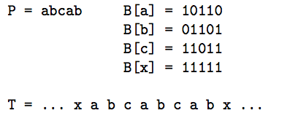
Example of working in the inner loop of TSO.

Slide 48
Example (Cont…)
T= …x a b c a b c a b x…
a D= 1 0 1 1 0
j=1 c 1 1 0 1 1
b 0 1 1 0 1
D= 1 0 1 1 0
j=2 b 0 1 1 0 1 c 1 1 0 1 1
D= 1 0 1 1 0

Slide 49
Example (Cont…)
T= …x a b c a b c a b x…
D= 1 0 1 1 0
j=3 a 1 0 1 1 0
a 1 0 1 1 0
D= 1 0 1 1 0
j=4 x 1 1 1 1 1
b 0 1 1 1 1
D=1 0 1 1 0
E= 0 1 0 0 1

Slide 50
Drawbacks of Two-Way Shift-OR Algo
Not able to retrieve the position of the occurrence of the pattern but only its number.

Slide 51
Analysis - TSO
TSO is linear in the worst case and sub-linear in the average case.
The outer loop of TSO is executed n/m times. In each round, the inner loop is executed at most m − 1 times.
The most trivial implementation of popcount requires O(m) time. So the total time in the worst case is O(nm/m) = O(n).
The same analysis applies to TSA.

Slide 52
Example of String hashing and collision
String s = “my name is kaitav”;
char c = s.charAt(6);
-e
System.out.println(c);
int i = s.charAt(6);
System.out.println(i);

Slide 53
Example of String hashing and collision
Hashcode for “this” : 116+105+104+115 = 440
ASCII
UNICODE
T h I s 116 105 104 115
Similarly hashcode for hits and tish will be same, so some hash function is required to reduce no of colloisons.
x x x x _g⁰ g¹ g² g³

Slide 54
Example of String hashing and collision
public int hashcode(String s){
int g = 31;
int hash = 0;
for(int i=0; i<s.length; i++){
hash = g* hash + s.charAt(i);
}
return hash;
}

Slide 55
Improvements of BSDM algorithm
Main Idea: Reduce the number of false positive detected during the searching phase in order to reduce the number of naive tests
It can be achieved by using an effective hash function in the implementation of condensed alphabet

Slide 56

Improved Hash Functions for Condensed Alphabets
Group of q adjacent characters of the pattern are condensed in a single character by using a suitable hash function- as shown in previous hashing example
Pattern P of length m translates in a condensed pattern
For every x, xє∑^{q} x=x [0… q-1] then h(x) can be computed by

Slide 57
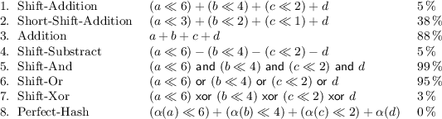
Improved Hash Functions for Condensed Alphabets
8 different hash functions were evaluated in terms of collisions and performance
No. of collisions partially reflects the performance of the algorithm, and it is also affected by the number of operations needed for computing hash value

Slide 58
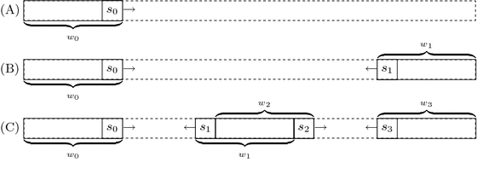
Multiple sliding Windows Variant of BSDM
Processing K no. of windows at the same time over the text , k>= 2
Sliding window ends when the one window slides over other window
Figure represents search iteration for k=1,2 and 4

Slide 59
Multiple sliding Windows Variant of BSDM
Drawback: When the alphabet is small as in the case of DNA, the performance of original algorithm degrade by applying the new method
It is proved in the paper by the experiment they have carried out

Slide 60
Conclusion and Future Work
From the experiments results it is concluded in the paper that the new versions of BSDM algorithm turn out to be competitive with previous solutions and obtain best running times in most practical cases
It will be interesting if the proposed new version of BSDM can be generalized in case of multiple pattern matching on genome sequence

Slide 61
References
Faro, Simone. "Evaluation and improvement of fast algorithms for exact matching on genome sequences." International Conference on Algorithms for Computational Biology. Springer, Cham, 2016.
Hirvola, Tommi, Hannu Peltola, and Jorma Tarhio. "Improved Two-Way Bit-parallel Search⋆." Prague Stringology Conference 2014. 2014.
Navarro, Gonzalo, and Mathieu Raffinot. "A bit-parallel approach to suffix automata: Fast extended string matching." Annual Symposium on Combinatorial Pattern Matching. Springer, Berlin, Heidelberg, 1998.
Baeza-Yates, Ricardo, and Gaston H. Gonnet. "A new approach to text searching." Communications of the ACM35.10 (1992): 74-82.
Lecroq, Thierry. "Fast exact string matching algorithms." Information Processing Letters 102.6 (2007): 229-235.

Slide 62
Questions?

